Slide 1


Online based computerized and automated Blood Bank Management system
COURSE NAME: SOFTWARE REQUIREMENT ENGINEERING
COURSE TEACHER : DR. MD. ABDULLAH - AL - JUBAIR
SECTION : E

Slide 2
Group Members Info
Serial no | Members Name | Members Id
38 | MEHEDI HASAN EMON
16 | MD REDOY SHEIKH
13 | KAZI AHSANUL HAQUE SHOJIB
 | RIFAT AHMED
06 | UMME HABIBA NAZRIN

Slide 3

Table of Content
Introduction
Problem Statement and Current Scenario
Requirements:
User Requirement
Functional Requirement
Business requirements
System Requirement
Software requirement specification
Context diagram
Product Vision and Project Scope
Constraints
Conclusion

Slide 4
Introduction
The inspiration of this project is to improve blood banks in our country and to develop a blood bank information system which focuses on making an online system that is accessible for both donors and recipient.
Donors can directly receive information regarding their previous blood donations, including their blood results and donation history, in order to easily schedule their next donations.
They can also update the personal information through the system, without having to contact the blood bank registry.
The user will easily contact through our automated massaging system by providing necessary information.

Slide 5
User Requirements
There are two internal users involved in this system. The user requirements are considered as follows:
Recipient: An online based computerized system
To be able to ask ques about and auto reply will generate from our Bot management system. For that This project is originated on an android APP, this will help to find the donors. Blood donor will participate indonor list using APP. Suppose if any need in blood, will get the donor list in this APP. Here in this APP, all types of Blood group (A+, B+, O+) Data base is established

Slide 6
User Requirements
Donor:
To be able to view their donation records, including where and when they made donations, and the blood results for each, to learn of their donated blood quality and schedule their next donations.
To be able to view and update their personal information, including name, contact address, and phone number, to keep their donor’s information record up to date with the blood bank.
To be notified of the blood results of their previous donation by e-mail, to know the success of their donation.

Slide 7
Functional Requirements
Access Website
User Registration (Both Apps & Website)
User log-in
Search result in a list view
Request Blood
View Request
Search Blood Bank Stock
View Order Details
View Delivery Status

Slide 8
Business Requirements
Emergency communication will be made to eliminate the problem
The amount of blood bank service providers can be reduced so that the cost can be reduced
With this system users will be able to easily collect the blood bank information of a new location so that the money spent by the users to find the blood bank will be reduced.
Any hospital will be able to update their blood bank information if they want. This will allow them to use blood at the right place at the right time.

Slide 9
System Requirements
Operating System:
Windows XP or Higher IDE : VisualStudio.NET Front End : ASP.NET Language : C#.NET Database : mysql
Hardware Requirements:
• Intel P4 1.5GHz or above • 512MB RAM • 80GB HDD Minimum

Slide 10
SOFTWARE REQUIREMENT SPECIFICATION (SRS)
Purpose
Limitations: End user’s will not be able to get the information about the availability of the blood in the bank of which he/she donated. Only the Admin has all right to edit the things in the End User’s Profile
Non-Functional Requirements

Slide 11
SOFTWARE REQUIREMENT SPECIFICATION (SRS)
Security: The system use SSL (secured socket layer) in all transactions that include any confidential customer information. The system must automatically log out all customers after a period of inactivity Performance The system is interactive, and the delays involved are less.
When connecting to the server the delay is based editing on the distance of the 2 systems and the configuration between them so there is high probability that there will be or not a successful connection in less than 20 seconds for sake of good communication. Reliability
As the system provide the right tools for problem solving it is made in such a way that the system is reliable in its operations and for securing the sensitive details

Slide 12
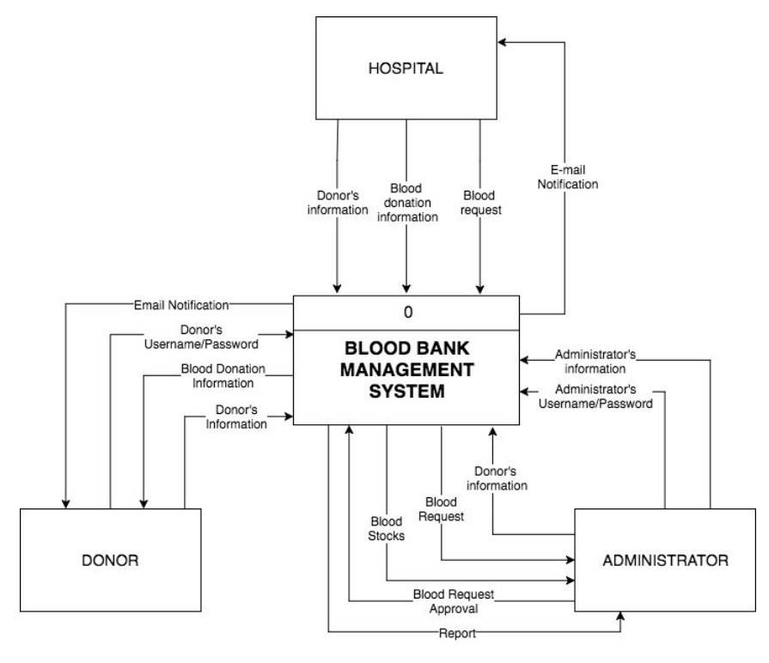
Context Diagram

Slide 13
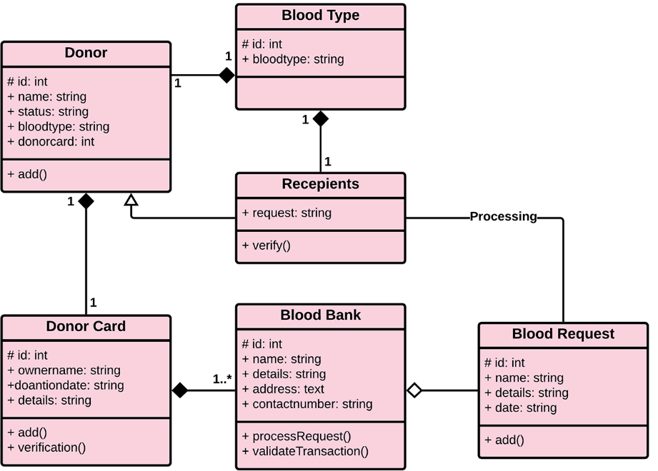
Product vision and project scope

Slide 14
Product vision and project scope
Support the automated tracking of blood products from the initial ordering of a blood transfusion for a patient, Emergency issue of blood;
Management of returned and unused blood units.
Routine blood transfusion
Emergency issue of blood
Users will be able to easily collect blood bank information of a new location, thus reducing the cost of users searching for a blood bank.

Slide 15
Constraints
The Donor and the acceptor are constrained to create an account first to avail the services
The internet connection is also a constraint for this web application
The web application is also constrained by the database capacity, so it works well with a smaller number of donors and hospitals
The access to manage the databases are different for different people. The receptionist is given the access to maintain the database of the registered donors and hospitals. The inventory manages is allowed access to update the inventory details and payment of the order placed by the hospitals

Slide 16
Conclusion
Online based computerized system will help the needy people by providing them the donation and make donation easier and more reliable for the people who are willing to donate. Also, our system will help many people to find the blood as soon as possible and here our apps, website and automated messaging system will solve this problem.

Slide 17

Thanks FOR BEING WITH US

Slide 18

ANY QUERY ?

